Slide 1

D-Mart: Unpacking Sales & Customer Insights
Welcome to our deep dive into D-Mart's performance! This presentation will highlight key sales trends and provide a comprehensive customer summary, helping us strategize for future growth and enhanced customer satisfaction.

Slide 2

Overview of Sales Performance
D-Mart continues to demonstrate robust sales growth. Our latest figures indicate a strong upward trajectory, fueled by strategic initiatives and sustained customer loyalty. We're consistently exceeding our targets.

Slide 3
Sales Trends by Product Category
45%
25%
Groceries
Home & Kitchen
Staple items driving consistent daily sales.
Steady growth, reflecting increased demand for household goods.
15%
10%
Apparel
Electronics
Seasonal spikes and popular collections contributing significantly.
Emerging category with high-value, albeit lower volume, sales.
Our sales data reveals that groceries remain our strongest category, while home and kitchen products show promising growth. Apparel and electronics also contribute meaningfully to our overall revenue.

Slide 4

Customer Demographics
Understanding who our customers are is crucial. Our data indicates a diverse customer base, with a strong presence of families and young professionals. This demographic mix allows us to tailor our offerings more effectively.
Age Group: Predominantly 25-55 years old
Family Status: High percentage of families with children
Income Levels: Middle to upper-middle income households
Geographic Spread: Strong in urban and suburban areas

Slide 5






Customer Purchase Behavior
Frequency of Visits
Regular visits suggest D-Mart is a preferred choice for daily and weekly shopping needs.
Average Basket Size
Customers are purchasing more items per visit, indicating strong brand loyalty and comprehensive product offerings.
Spending Habits
Insights into preferred payment methods and high-value product purchases.
Our customers show consistent purchasing patterns, often making large, multi-category purchases. This behavior highlights our effectiveness in being a one-stop-shop for their diverse needs.

Slide 6
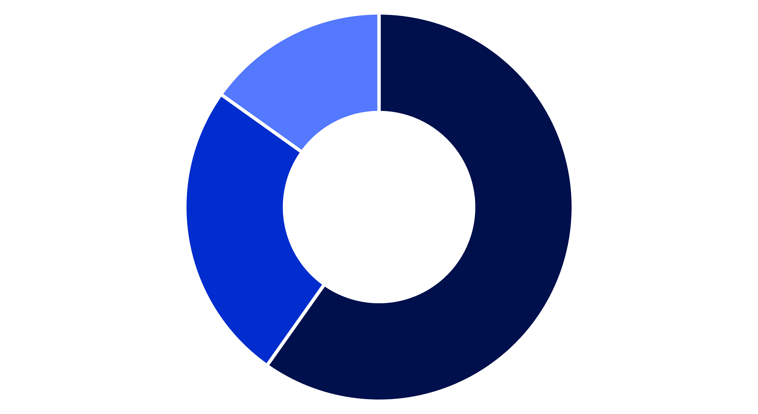
Customer Loyalty and Retention
Highly Loyal
Regular Shoppers
New Customers
Our loyalty programs and excellent customer service have cultivated a strong base of highly loyal customers. We are also seeing a healthy influx of new customers, which bodes well for continued expansion.

Slide 7



Enhancing Customer Experience
Feedback Integration
Personalized Offers
Digital Engagement
Actively listening to customer feedback to refine our services and product offerings.
Leveraging data to provide tailored promotions and recommendations.
Improving our mobile app and online presence for seamless shopping.
Continuous improvement of the customer experience is at the core of our strategy. By focusing on feedback, personalization, and digital convenience, we aim to elevate every interaction.

Slide 8

Key Takeaways & Next Steps
D-Mart's strong sales performance is driven by a loyal and diverse customer base. Our next steps involve deepening customer engagement through personalized experiences and exploring new product categories to maintain this momentum. We will continue to leverage data for smarter decision-making and sustainable growth.

